Slide 1
Brazilian E-Commerce
Logistics Performance Analysis
Performed by Leon

Slide 2
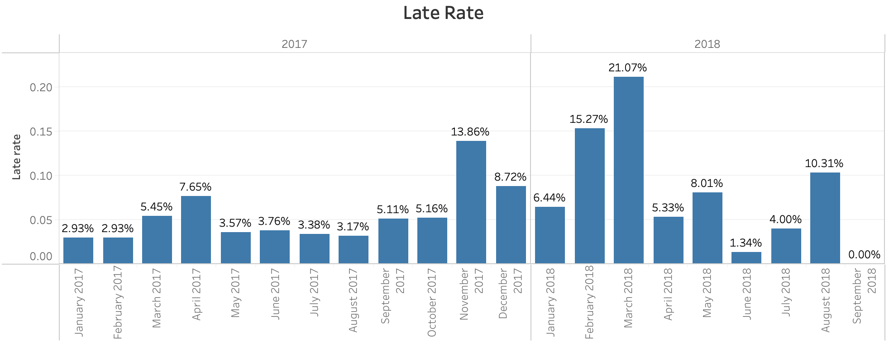
Late Delivery Overview
Late delivery was high during 2017.11 to 2018.05
Increasing trend from 2018.07 → Action plan needed.

Slide 3
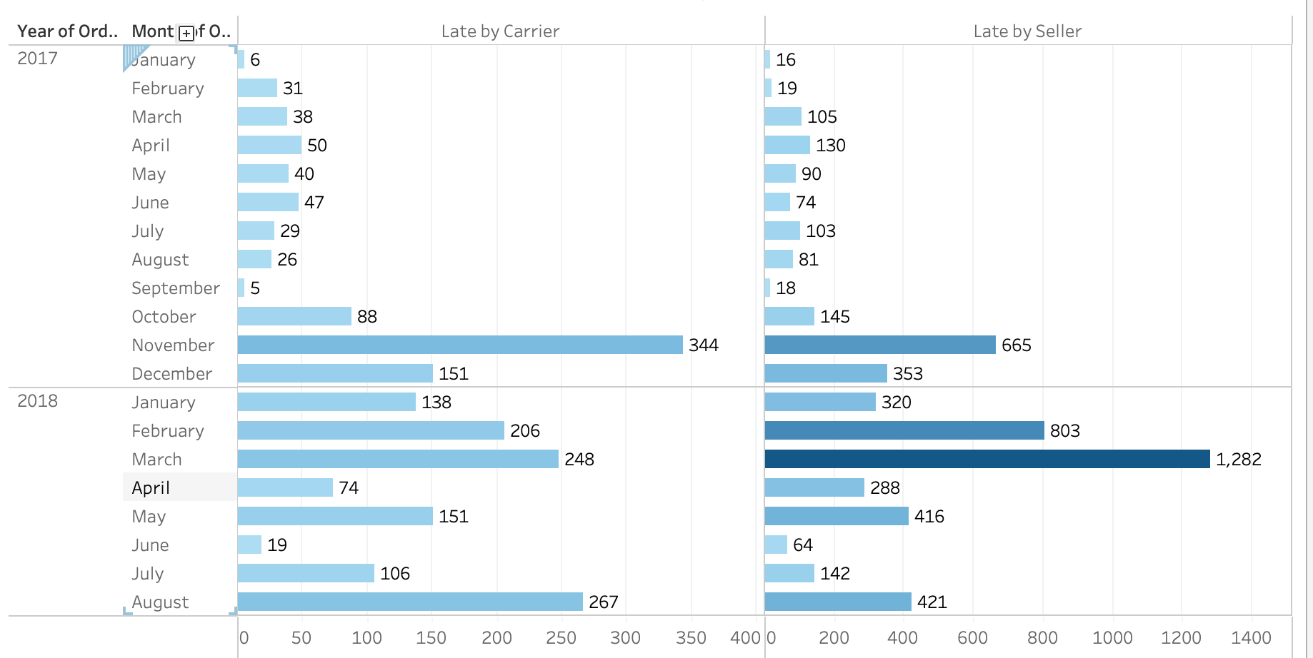
Late Delivery Duty – Seller and Carrier
Higher on Seller

Slide 4
Strategies for improving late delivery
Seller
Carrier
Incentive
Less platform fee
Display “Excellent Seller” badge
More shipment assigned
Partnership in additional business opportunity
Punishment
Punishment fee
Warning
Less shipment assigned
Cancelled logistics contract

Slide 5
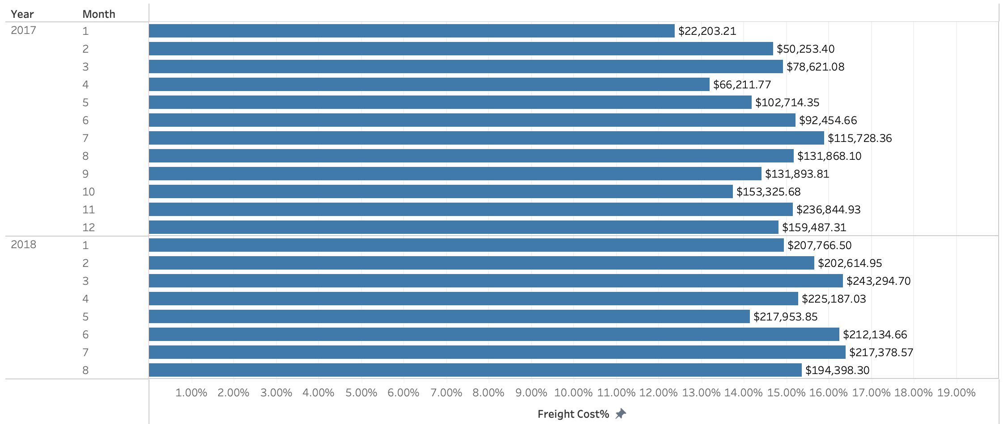
Freight Cost Percentage
Stable between 12% to 17% (freight cost / price)
Lowest: 12.38%
Highest: 16.4%

Slide 6
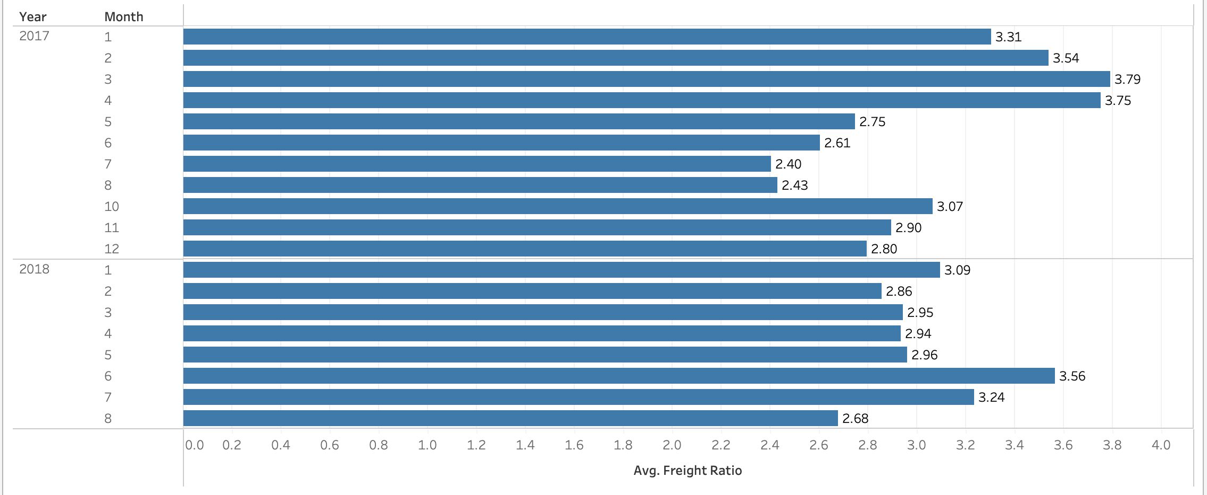
Freight Ratio
Freight Ratio = Freight Cost / (Volume/Weight)
Showing the cost-effectiveness → The higher the ratio, the more products we shipped under the same cost.
Higher efficiency
Lower efficiency

Slide 7
Strategies to improve cost-effectiveness
Maintaining the Freight Ratio above 3
Transportation Type
(Truck, Rail, Air…)
Carrier Negotiation
Order Consolidation

Slide 8
Action Plan
Define benchmark for each KPI
Weekly analysis to monitor performance
Setup automatic alert to identify low performance
Enhancement

